Slide 1
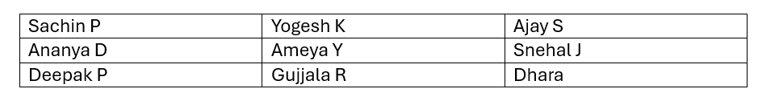
Team A: Data Control
By-

Slide 2
Agenda
Data Quality Process
Objective
Data Fixing
Data Control
Data Cleaning
Objective & Data
Feature-wise Control Rules
Existing Data Samples
Proposed Controls
Define and enforce data quality rules for “Control” use cases
Minimize manual oversight through rule-based automation
Improve reliability and traceability of key features
AMAG Indonesia Historic Source Data
Choice of Data

Slide 3
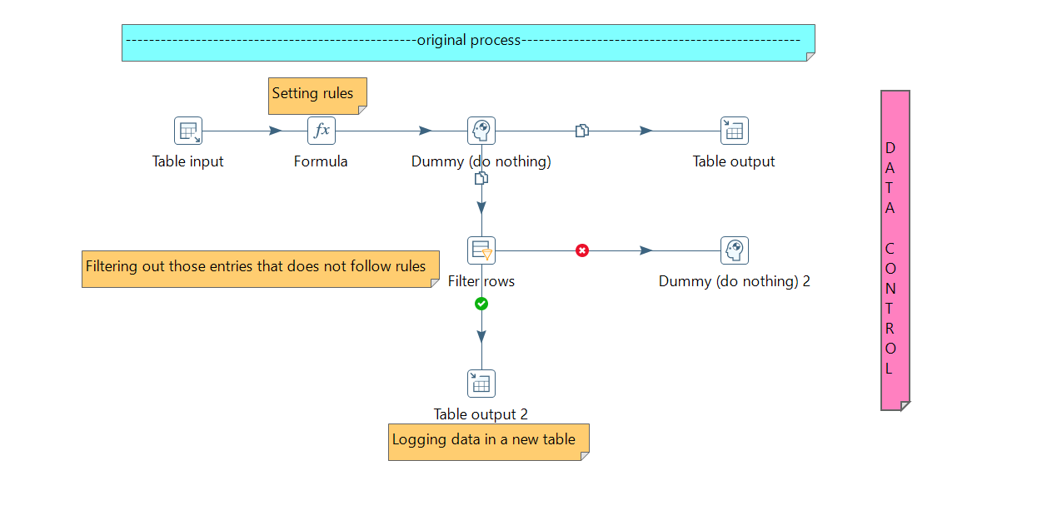
Data Quality Control Flow
Features over which control has to be implemented
Attributes
Dates
Source name
Manufacturer name
Model name
Customer Email
Channel

Slide 4
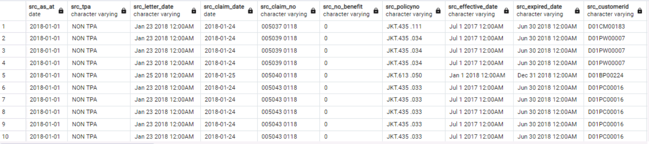
Feature-wise Control Rules & Examples
Date
Data is in correct YYYY-MM-DD format
Data is in incorrect format

Slide 5
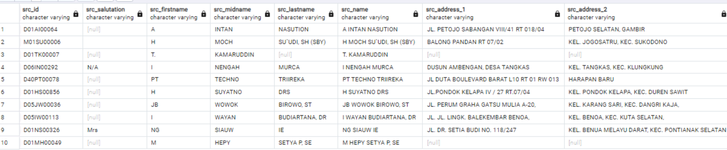
Feature-wise Control Rules & Examples
Source name is illogically short or ambiguous
Source name

Slide 6
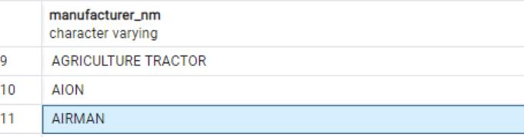
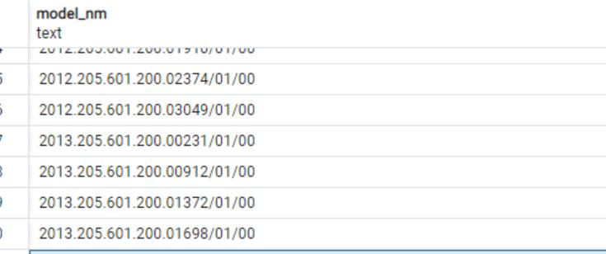
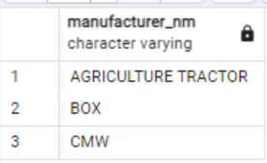
Feature-wise Control Rules & Examples
Model’s name
Manufacturer’s name
Few manufacturers don’t exist in real
Few model names are invalid

Slide 7
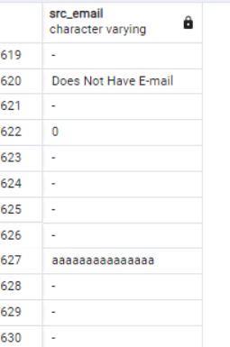
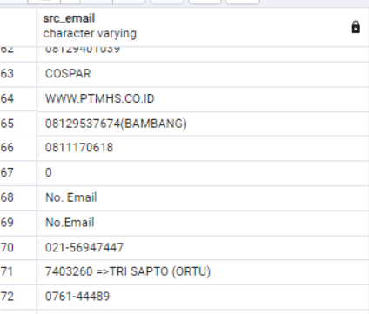
Feature-wise Control Rules & Examples
Invalid email IDs are inputted
Customer’s Email

Slide 8
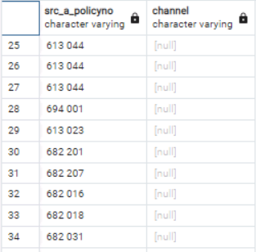
Feature-wise Control Rules & Examples
Missing Channels present for policy records
Channel

Slide 9
Proposed Controls
Attributes | Problem | Proposed Solution
Date | Not in YYYY-MM-DD | Validate as YYYY-MM-DD.
Source name | Ambiguous & Not Divided properly (First, Middle, Last) | Ensure source name is correctly filled.
Manufacturer’s name Model’s name | Data is invalid cz they don’t exist | Validate against a predefined list.
Customer’s Email | Not in correct format (just filled with random values) | Check if the email domain (after @) matches any of the predefined global or Indonesian domains
Channel | Missing channels are present | Match to a predefined list.

Slide 10
Thank you.
☺

